Slide 1
The event will begin momentarily.
This event is being recorded
Captions are available by clicking the CC icon in the Zoom toolbar below
ASL is provided
For more information and to download presentation materials visit: www.access-board.gov/av

Slide 2




Inclusive Design of Autonomous Vehicles: A Public Dialogue
Accessibility for Passengers with Sensory and Cognitive Disabilities: Part 1
Ride hailing and on-board communication

Slide 3
Agenda
Rutgers University – Dr. Cecilia Feeley and Andrea Lubin
Q & A
University of Michigan – Dr. Robin N. Brewer
Q & A
National Federation of the Blind – Anil Lewis
Q & A
Gallaudet University – Dr. Christian Vogler
Q & A
Open Dialogue
PowerPoint slides are available for download from:
www.access-board.gov/av

Slide 4
How to Participate
Ask Questions to Presenters
Submit questions using Zoom’s Q & A feature throughout the event
Ex. “Question – What are wheelchairs?“
Ex. “Question for the first presenter – Did your study look at scooters?”
Moderator will paraphrase question to presenters
We may not get to all questions
As an alternative, you may submit questions via email: events@access-board.gov
Contribute to the Open Discussion Today
Request to speak using Zoom’s Q & A feature
Ex. “Microphone – I’m Beth from XYZ Company and would like to talk about automated doors”
Ex. “Microphone – I’m Alex and I’d like to share my experience using an AV”
Host will unmute you (in Zoom), but please check your microphone
Moderator will call on you by name to speak
ASL – If you wish to be visible for signing, please put that in your request
Continue the Online Dialogue
http://transportationinnovation.ideascale.com
For assistance, email: ePolicyWorks@dol.gov

Slide 5
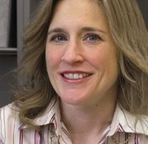
Dr. Cecilia Feeley
Rutgers University

Slide 6
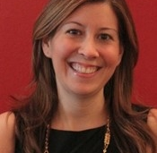
Andrea Lubin
Rutgers University

Slide 7

Accelerating Mobility for All:
Highlights of Focus Group Feedback from Persons with Disabilities Following Autonomous Vehicle Rides
Cecilia Feeley, Ph.D. and Andrea Lubin, M.S.
U.S. Access Board
Accessible AV Forum
April 7, 2021

Slide 8
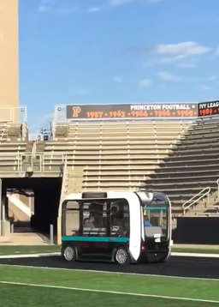
PROJECT OBJECTIVE
To expand limited body of research on designing & deploying Autonomous Vehicles (AV) to accommodate diverse needs of persons with disability(s)
How?
Convene a series of focus groups with persons with disabilities who experienced an autonomous shuttle ride to capture their feedback

Slide 9

WHY AUTONOMOUS VEHICLES?
Transportation access KEY for successful integration of persons with disability(s)
AV innovation could offer a VIABLE transportation option
USDOT & NHTSA supportive of AV development
Many states moving towards AV legislation

Slide 10
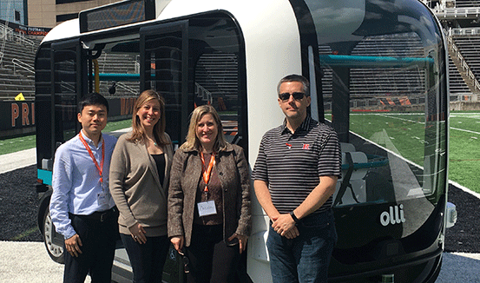
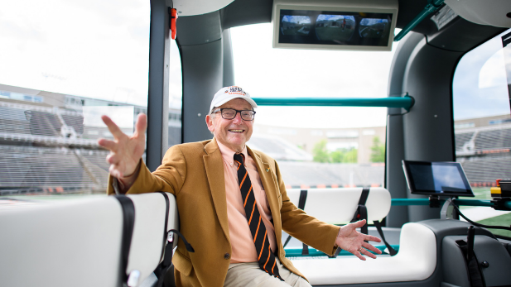
METHODOLOGY: QUALITATIVE RESEARCH
Joint research initiative - Rutgers University and Princeton University
Focus groups (4) with a total of 21 participants
Study inclusion criteria
Study limitations
Bottom photo credit: Steven Schultz

Slide 11
PARTICIPANT DEMOGRAPHICS
Characteristics | Respondents | Percent
Gender
Male | 14 | 67%
Female | 3 | 14%
No Answer/Not Disclosed | 4 | 19%
Race
White not Hispanic | 7 | 33%
Black not Hispanic | 1 | 5%
White Hispanic | 4 | 19%
Black Hispanic | 0 | 0%
Asian | 3 | 14%
Native American | 0 | 0%
Hawaiian/Pacific Islander | 0 | 0%
Other | 0 | 0%
No Answer/Not disclosed | 6 | 29%
Age
18-21 | 3 | 14%
22-29 | 11 | 52%
30-39 | 3 | 14%
40-49 | 0 | 0%
50-64 | 2 | 10%
65+ | 0 | 0%
No Answer/Not Disclosed | 2 | 10%
Education
High School No Degree | 2 | 10%
High School Degree | 5 | 24%
Some College No Degree | 4 | 19%
Associated Degree | 2 | 10%
Bachelor’s Degree | 0 | 0%
Graduate Degree | 1 | 5%
No Answer/Not Disclosed | 7 | 33%
Living Arrangement
With Parents | 14 | 67%
With Spouse/Partner | 2 | 10%
Group Home | 1 | 5%
No Answer/Not Disclosed | 4 | 19%

Slide 12
FINDINGS: INITIAL IMPRESSIONS
“It looks so cool”
Vehicle initial impressions
Physical appearance
Entering & exiting – “easy” & “smooth”
Participants with visual impairments note handrail and low-step very helpful
“It looks so futuristic”
“Amazing”

Slide 13
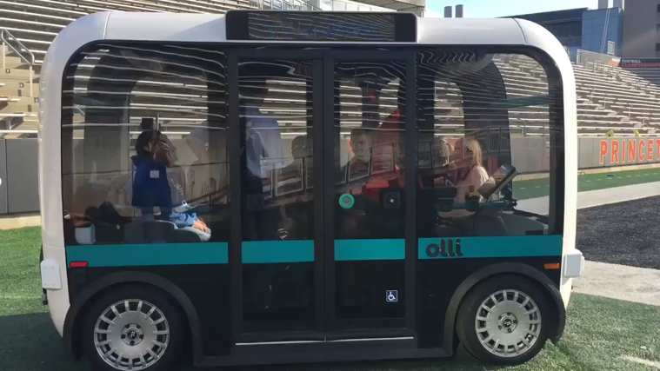
FINDINGS: ON-BOARD EXPERIENCE
All enjoyed the trip:
“Smooth,” “Comfortable,” “Slow”
On-board sounds/noises
Only one shared negative noise feedback
Large windows +
On-board video monitoring +

Slide 14

FINDINGS: AV INTEREST
17 of 21 interested in traveling again via AV…..Why?
Travel “freedom”
Increased “independence”
Decreased “isolation,” “depression,” “jealousy”
Preference over other modes, especially if available “on-demand”

Slide 15



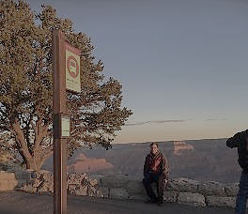
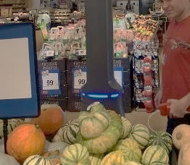
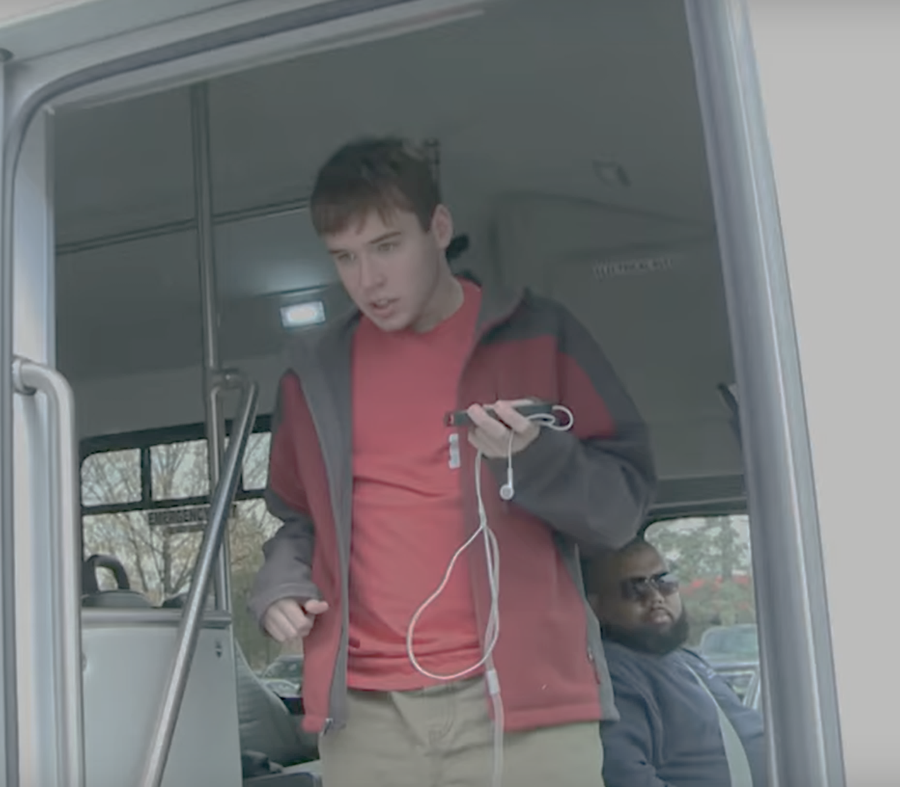
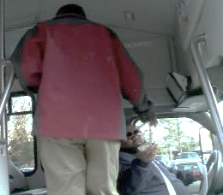
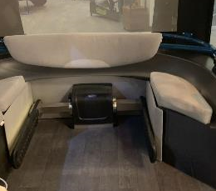
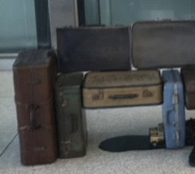
FINDINGS: AV INTEREST
Oh, the Places You'll Go!
On-board personal assistance?
SOCIAL / RECREATION
EMPLOYMENT
EDUCATION
TRANSIT FEEDER
DAILY
LIVING
BOARDING &
ALIGHTING
PAYING FARE
SECUREMENT
CARRYING BAGS

Slide 16
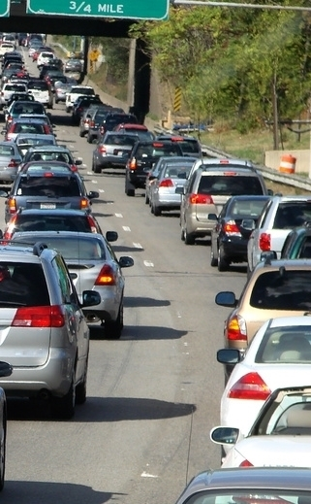
FINDINGS: CONCERNS WITH AV
Vehicle accessibility critical
Kneeling feature
Wheelchair lifts
On-board audio capabilities & multi-sensory supports
Vehicle safety
On-board cameras
Capable audio and visual sensors
On-board attendant
Three-point seatbelt configuration
Maintain speed with traffic flow

Slide 17
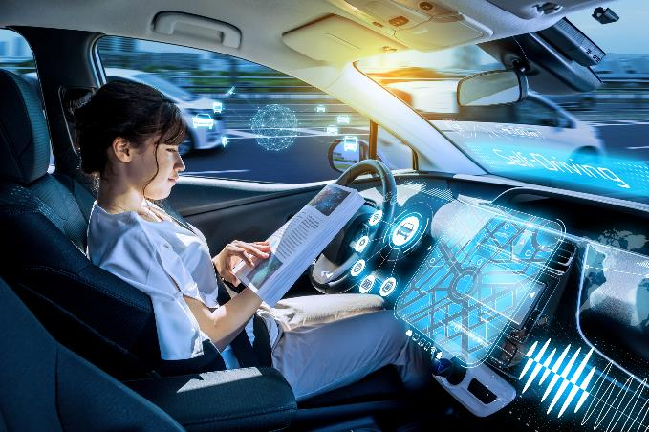
FINDINGS: CONCERNS WITH AV
Communication interface
How can I schedule my trip?
Can I engage in a ‘conversation’ with the AV communication interface?
Can I secure live assistance via the communication interface?

Slide 18
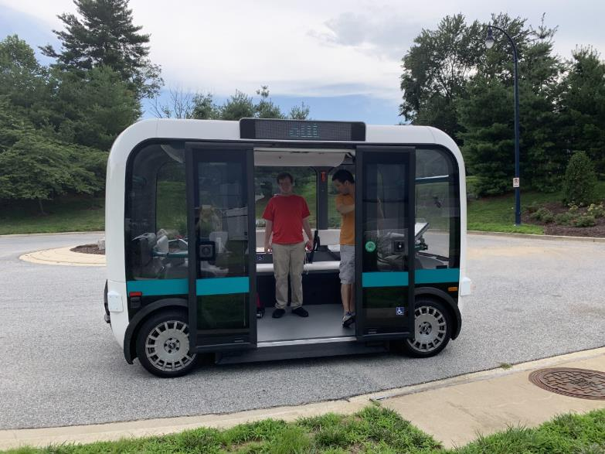
FINDINGS: CONCERNS WITH AV
Comfort and design
Availability
Cost

Slide 19
CONCLUSIONS & TAKEAWAYS
Very POSITIVE feedback on vehicle initial impressions & trip experience
Most interested in using AV again
Most did not anticipate needing personal assistance on-board, but support an on-board attendant for safety reasons
Most feedback did not differ based on participant disability type
AV concerns & recommendations focused on accessibility, safety, communication interface, design, cost & availability factors

Slide 20

For More Information
Cecila Feeley, Ph.D. Transportation Autism Project Manager 848.445.2975 / cfeeley@soe.rutgers.edu
Andrea Lubin, M.S. Senior Researcher 848.932.2861 / annlubin@ejb.rutgers.edu

Slide 21
Questions?

Slide 22

Dr. Robin N. Brewer
University of Michigan

Slide 23
Automated Vehicles for Blind and Low Vision People: Open Design Challenges
Dr. Robin Brewer
04.07.2021

Slide 24
“While blind people get around by using mass transit and other things, we don't have the flexibility the autonomous vehicles will present”
John G. Paré Jr., executive director for advocacy and policy at the National Federation of the Blind

Slide 25
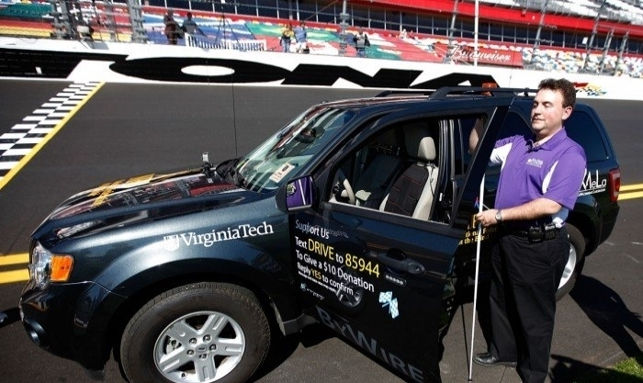
Blind Driver Challenge
National Federation of the Blind, Virginia Tech

Slide 26
1. Designing for barriers of automated vehicles DESIGN FOCUS GROUPS 2. Designing for AI-powered transportation challenges INTERVIEWS WITH RIDESHARING PASSENGERS AND DRIVERS

Slide 27
Research Question (RQ)
RQ:
How can we design accessible systems to support blind and low vision people with differing levels of control in automated vehicles?
2 focus groups with N=15 blind and low vision people
(7 women, 35-76 years old, mean = 59)
Brewer, Robin N., Kameswaran, V. "Understanding the power of control in autonomous vehicles for people with vision impairment." Proceedings of the 20th International ACM SIGACCESS Conference on Computers and Accessibility. 2018. https://bit.ly/blindavcontrol

Slide 28
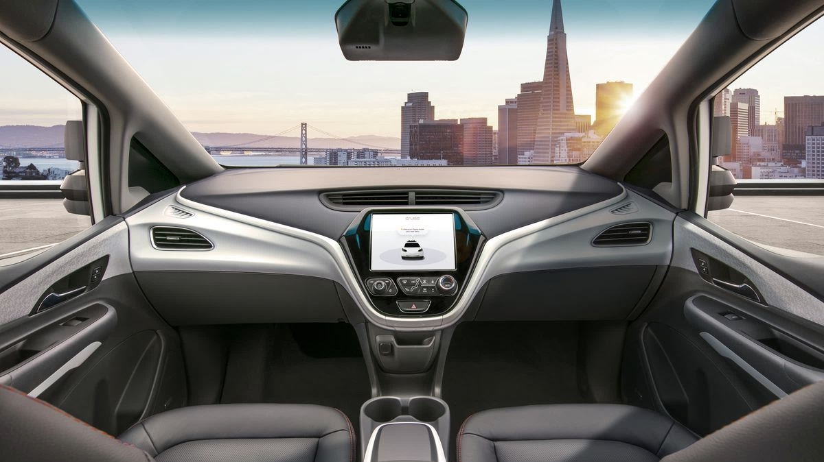
Unexpected autonomy
“the ability for you to take over and still have some type of tactile signals given to you and say ‘this is not working. This is not going to work’ and you can still achieve your, you know, independence” – P14
source: verge.com

Slide 29
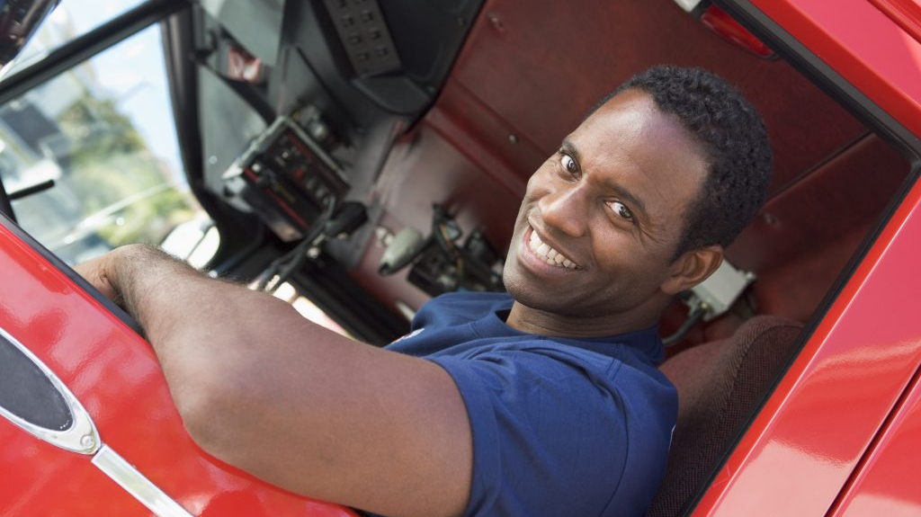
Identity as a driver
“that’s what I did for a living as a transportation equipment operator for public transportation”
“I warm the car up, the vehicle, for my wife every day…I start it up and pull it out the garage. So, it takes a skill to do that” – P7

Slide 30
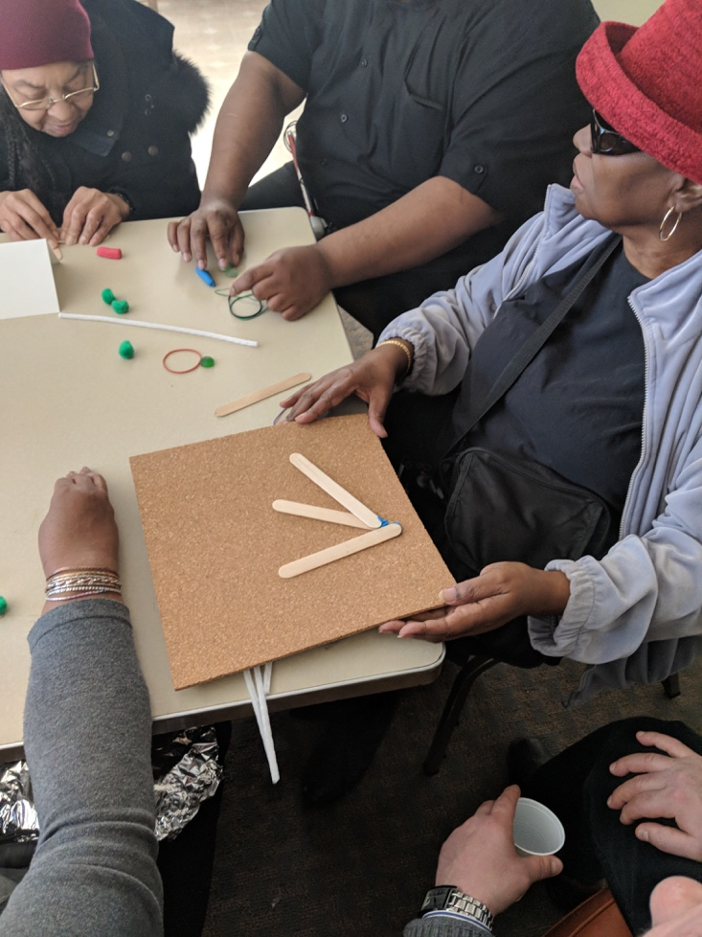
Designing for Control
Malfunction
Misinterpretation
Trust
Anxiety

Slide 31
Metaphor-Based Design
“as you’re driving with your hands at 10 and 2, you can use your thumbs …So, it’ll work kinda like a Refreshable Braille Display that can move up as vehicles are approaching on the left and right” (P14)

Slide 32
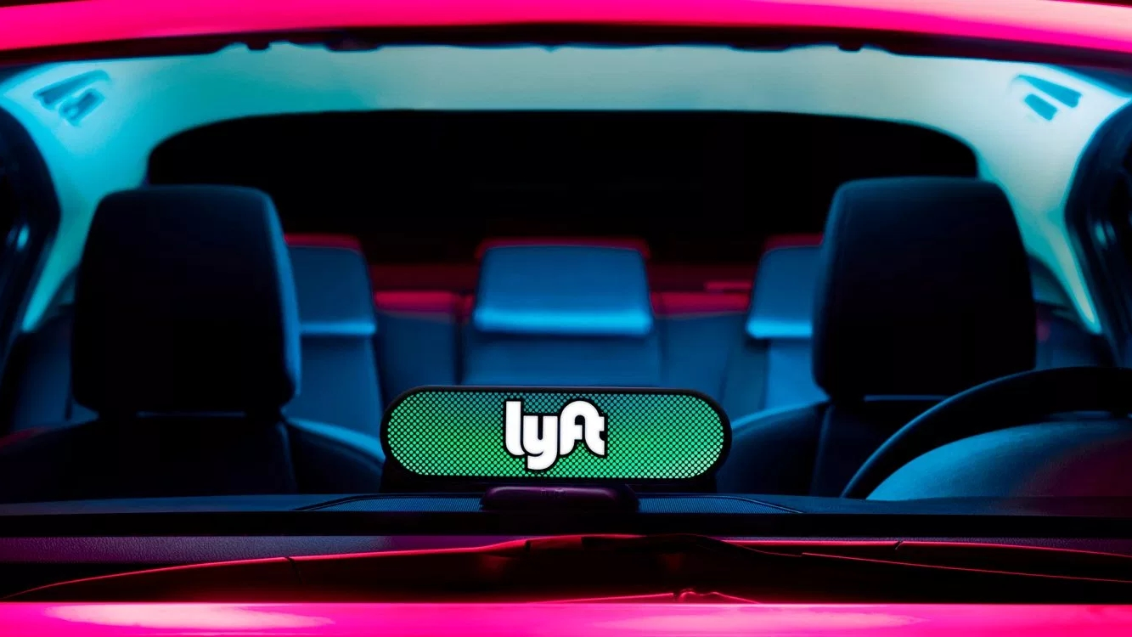
What can we learn from existing transportation behaviors to inform the design of AI-powered automated vehicles for disabled people?
Brewer, Robin N., and Vaishnav Kameswaran. "Understanding trust, transportation, and accessibility through ridesharing." Proceedings of the 2019 CHI Conference on Human Factors in Computing Systems. 2019. https://bit.ly/blindavpassengers
Brewer, R. N., Austin, A. & Ellison, N. B. (2019). "Stories from the Front Seat: Supporting Accessible Transportation in the Sharing Economy." Proceedings of the ACM Human-Computer Interaction 3(CSCW): Article 95. http://bit.ly/avfrontseat

Slide 33
Methods
Semi-structured interviews
16 blind and low vision ridesharing passengers in Greater Detroit area
Experiences, challenges and perceptions of other transportation modes
10 male, 6 female, mean 41.6 years
18 ridesharing drivers with experiences with blind, low vision, and other disabled passengers
12 male, 6 female, mean 51 years

Slide 34
Role of the driver
The inevitability of entry and exit assistance
"Well, sometimes they can’t always see where you are. They think you can see them and you tell them you can’t… For example, I waited out by my garage before and a guy swore he was at my house. And I said, ‘You’re not at my house ’cause I’m at the garage.’ He goes, ’I’m at the garage.’ I said, ’No you’re not, ’cause I’m right here’... He drove around, and he finally saw me."

Slide 35
Roles: (1) Physical labor
Drivers performed physical labor roles that required disability disclosure
‘I’ve just got a few things to move’. He goes, ’would you mind helping me?’ I grab boxes…We load them up, take him to his new apartment, and he goes,…’would you help me carry these up the steps?’ No problem, I would’ve done it if he wouldn’t have asked, I would’ve offered.
…He goes, ’would you let me hold onto your arm, and you walk me around the room so that I can memorize where everything is at?’...We walked around and we got to the thermostat for the heating and cooling. And he goes, ’tell me what each button is for on this’… (P13)
“
“

Slide 36
But: drivers acknowledged that others might use disclosures inappropriately
Drivers expected people to disclose their disability as it helped drivers feel more comfortable in knowing how (much) to assist
as a driver it would be nice to know ahead of time. However, I get the fact that they wouldn't want to tell us that ahead of time, also. ... There are predators out here and if somebody knew that that was a visually impaired person, they could plan it ... try to figure out some way to take advantage of them... (P2)
“
“

Slide 37
If we replace the human decision-maker (the driver) with an algorithm, does this problem go away?

Slide 38
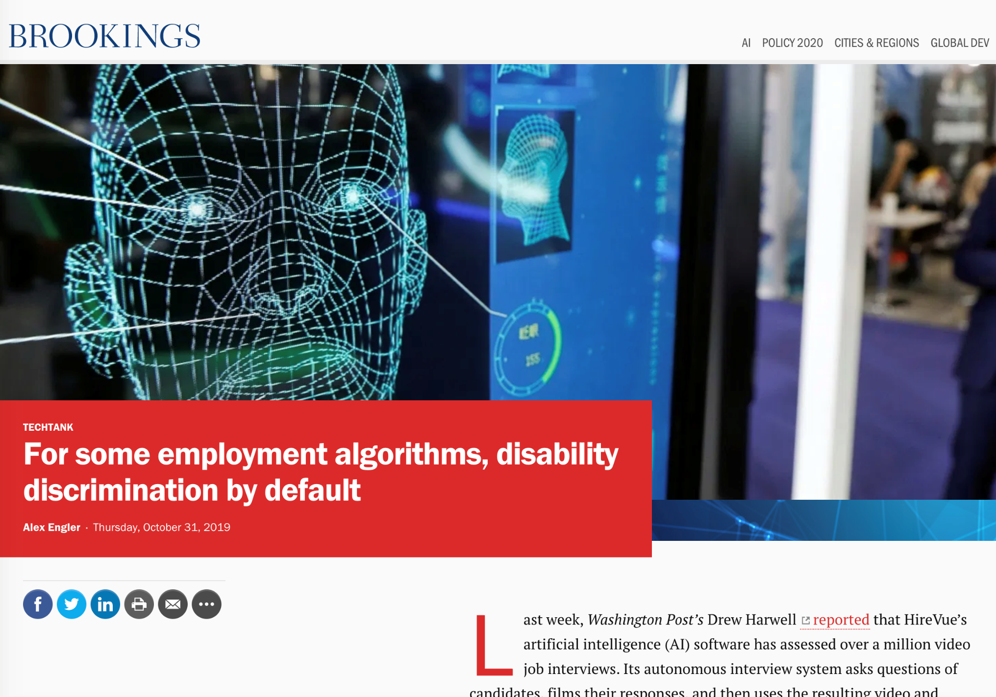
No

Slide 39
Summary
1
2
Designing for AV barriers DESIGN FOCUS GROUPS
Control is a spectrum, should it be a choice?
Designing with assistive tech metaphors
Understanding transportation INTERVIEWS w/ RIDESHARING PASSENGERS AND DRIVERS
Drivers play a critical role
Bias may still be a concern, even without drivers (people) making decisions

Slide 40
Thanks! Questions?
Robin Brewer Assistant Professor University of Michigan, School of Information rnbrew@umich.edu
Special thanks to collaborator, Nicole Ellison, and student researchers Vaishnav Kameswaran and Amy Austin
This research was funded by the Center for Connected and Automated Transportation

Slide 41
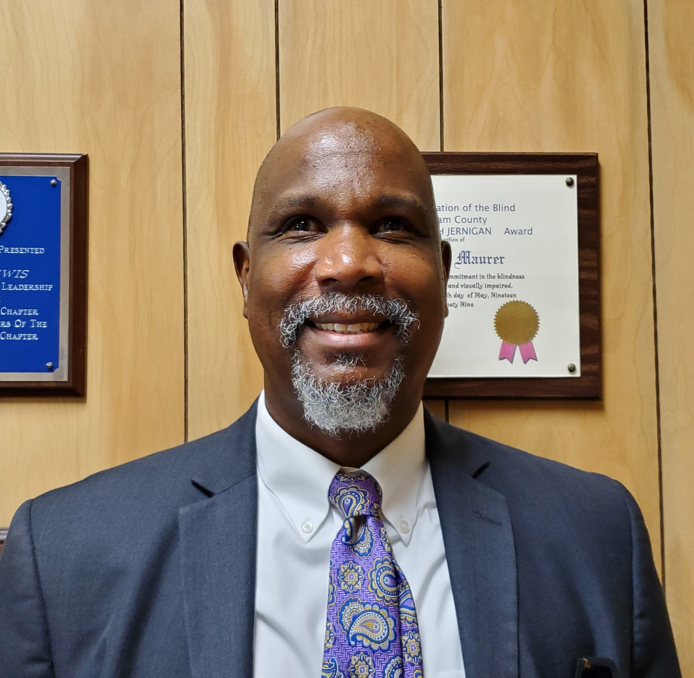
Anil Lewis
National Federation of the Blind

Slide 42
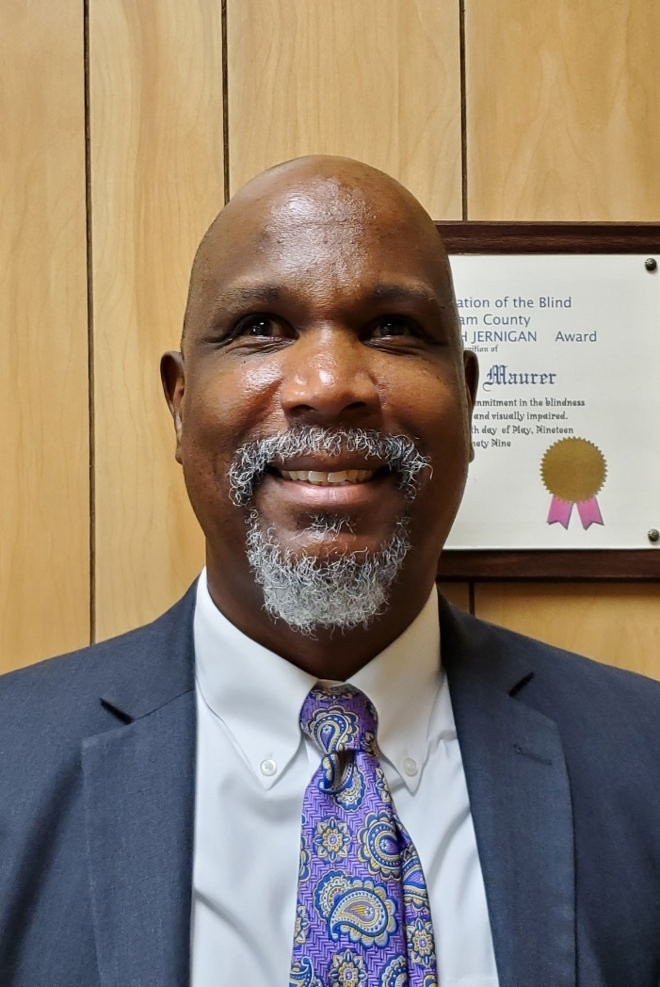

Anil Lewis

Slide 43
Questions?

Slide 44
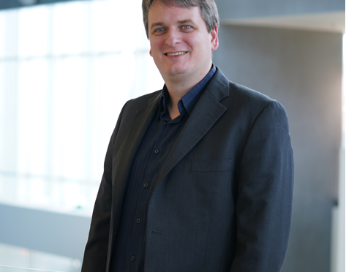
Dr. Christian Vogler
Gallaudet University

Slide 45
Autonomous Vehicles from a Deaf/Hard of Hearing Perspective
Christian Vogler, PhD Director, Technology Access Program Gallaudet University

Slide 46
It’s all about communication
Communicating to the vehicle what you need
Vehicle communicating key information to you
Communicating with entities outside the vehicle

Slide 47
Deaf/HH communicating to the vehicle
Voice commands are convenient for many, but a big problem for the deaf/hh
May need a different communication modality (e.g. ASL)
May prefer to talk, but voice interface doesn’t understand a deaf-induced accent
May need or prefer a tactile interface
Research priority: Robust, limited set of gestures and signs for command & control

Slide 48
Vehicle communicating to deaf/hh
Need visual alternatives to vehicle’s speech
Visual alternatives must provide appropriate detail, and appropriate level of alerts
Routine info must be helpful and not be distracting
Audio must be compatible with hearing devices
Direct wireless and loop connection options
Must be able to provide audio both to hearing device and through speakers in mixed deaf/hh/hearing passenger set

Slide 49
Communicating with the outside
Any audio-based communication with the outside must also have visual and text alternatives
The interfaces for visual and text communication must be accessible

Slide 50
Questions?

Slide 51

Open Discussion
Request to share information, ideas, or comments using Zoom’s Q & A feature:
Microphone – You will be allowed to speak
Question – You will not speak (moderator will read your question)
Name (and organization)
Brief description of content
Host will enter you into queue
Moderator will announce when it is your turn to talk
Host will unmute you in the Zoom platform
You may need to unmute locally (*6 by phone)
Moderator will also announce next in queue
Presenters may respond to some comments
Alternative: events@access-board.gov
ASL – note in request to comment
Limit your comments to less than two minutes

Slide 52
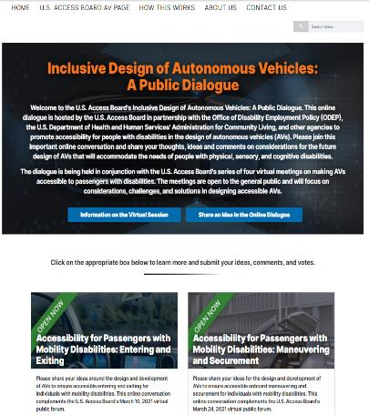
Online Dialogue
Continue the conversation Online
http://transportationinnovation.ideascale.com
Share ideas, comment, vote
For assistance, email: ePolicyWorks@dol.gov

Slide 53
Next Session
Accessibility for Passengers with Sensory and Cognitive Disabilities: Part 2
This session will continue discussion of communication accessibility in hailing and interacting with autonomous vehicles for passengers with hearing, visual, or cognitive disabilities.
April 21, 2021, 2:00 – 3:30 (ET)
Presenters:
Dr. Aaron Steinfeld, Carnegie Mellon University
Dr. Gregg Vanderheiden, University of Maryland
Darryl Cooper, Federal Communications Commission
Ted Guild, W3C
Bruce Bailey, U. S. Access Board
For updates, please see our AV landing page at: www.access-board.gov/av

Slide 54
Thank you for attending today's session.

